Slide 1
A Reassessment of the Relationship between Inequality and Growth
Kristin J. Forbes

Slide 2
Background
Kaldor and Kuznets: A trade-off between reducing inequality and promoting growth.
East Asian experience (initial low inequality and high subsequent growth) versus Latin American case.
Adding inequality as an independent variable in variants of Barro’s cross-country regressions. A negative impact of initial inequality on growth is found.

Slide 3
Problems with this Literature
Theoretically:
The negative relationship predicted by the models employed is far from definitive (examples: multiple equilibria; relationship depends on exogenous factors).
Recent models predict a positive relationship. Example: High inequality could mean a higher tax rate to finance public education chosen by the median voter and hence higher human capital and growth.

Slide 4
Empirically:
Relationship is not robust when a sensitivity analysis is performed.
Measurement Error (attenuation bias; more serious if the error is systematic), and Omitted Variable Bias (if “corruption” is omitted for instance there will be a negative bias; the opposite for “support for entrepreneurship”).
It doesn’t address how a change in inequality in a given country will affect growth within that country. For this question, panel techniques are indispensable.

Slide 5
Improved Inequality Statistics
Important since measurement error in inequality data is a significant problem.
Deininger and Squire (1996) High- Quality Dataset: Filtered out the observations of income inequality that satisfy the following: a) based on HH surveys, b) sample representative of the country, c) comprehensive measure of income.

Slide 6
Panel Data Versus Cross- Sectional
Deininger and Squire (1998) used this improved dataset to find a negative relationship (using cross- country regression).
When they included regional dummies, inequality becomes insignificant suggesting that there is omitted- variable bias.
Using panel data instead, one can control for differences in time- invariant country- specific unobserved characteristics. However, potential bias resulting from omitting time- varying regressors is still a problem.

Slide 7
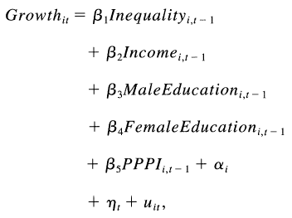
The Model
The model (1) used is:
This is used for 3 reasons:
Similar to models used in previous studies (especially Perotti (1996)).
Maximizes degrees of freedom (data available)
Reduces endogeneity by focusing on stock variables measured at the beginning of period.

Slide 8
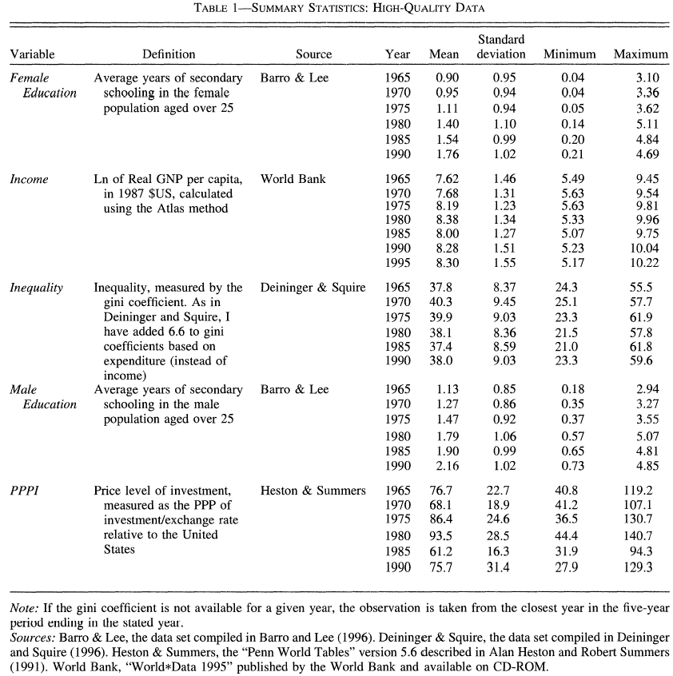
Data

Slide 9
Because of data availability, the focus is on growth in 1966- 1995.
To reduce serial autocorrelation from business cycles, the growth rates are averaged over 5- year periods. Hence, 6 periods can be estimated for each country.
Only countries with observations for at least 2 consecutive periods are included. Final Sample includes 45 countries and 180 observations.

Slide 10
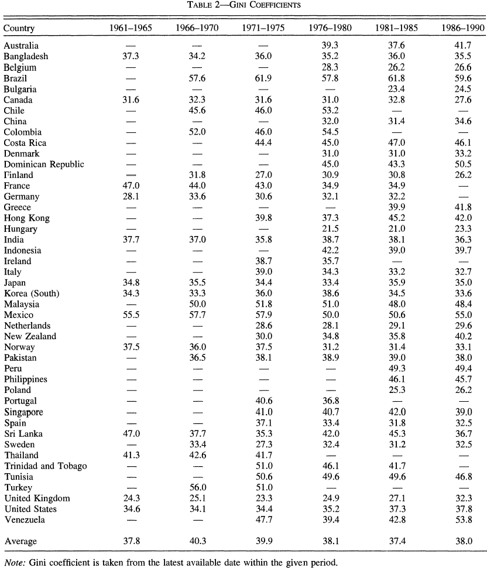

Slide 11
Data Problems
Limited number of observations for many countries (especially for earlier periods).
Regional coverage is not representative. Half the countries are from OECD. No countries from Sub-Saharan Africa. Few from transition economies.
Gini Coefficients are not based on identical units of account or exactly comparable surveys and samples across countries.

Slide 12
Estimation
Fixed Effects (FE) versus Random Effects (RE): FE allows for correlation between country fixed effects and the other regressors. It uses deviations from the mean within each country across time.
RE requires that the country random effects be uncorrelated to the regressors. It uses information across countries and over time. It is more efficient.
Hausman Specification Test is used to evaluate whether this assumption of independence between errors and RHS variables is satisfied.

Slide 13
But (1) Has Lagged Dependent Variable Problem
Since growth is difference in log income levels, and then lagged income is added to both sides of equation

Slide 14
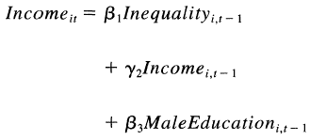



When this is done the new equation (2) can be written as
Where:
Or:

Slide 15
Even if lagged income y_{it-1}and u_{it}
For t finite (t = 6), both FE and RE are inconsistent and the coefficient of the lagged dependent variable can be biased significantly.
Chamberlain’s π-Matrix Technique: a popular remedy. However, it requires exogeneity of a whole set of explanatory variables; a requirement that is not met in this model. PPPI is possibly the only real exogenous variable. Hausman test can be used to test for exogeneity of RHS variables.

Slide 16
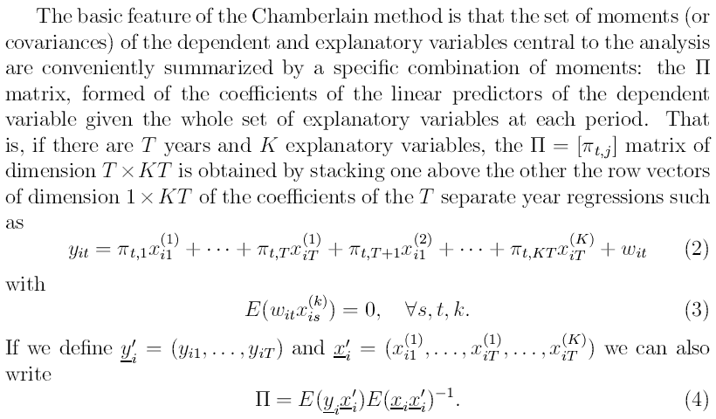
Background on Chamberlain’s Method

Slide 17
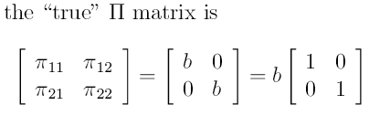

So for instance, in the model:
In the first stage, π’s can be estimated using the sample counterpart of this linear projection equation. In the second stage, b can be retrieved from π using Asymptotic Least Squares (ALS) to the equation:

Slide 18
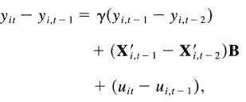
Another method that allows for endogeneity of the regressors is Arellano and Bond GMM (1991).
This method first- differences each variable to eliminate the country- specific effect, then uses all the possible lagged values as instruments.
The model is rewritten as:
For period 3, the regressor is instrumented by . For period 4, is instrumented by a and

Slide 19

For this method to be applied:
Estimates by these various methods presented in Table 3
Hausman Test for FE versus RE rejects the assumption needed for RE. Another Hausman test for the exogeneity assumption needed for Chamberlain’s method also rejects this assumption.
But the assumptions for Arellano and Bond are satisfied justifying estimates in col. (4).

Slide 20
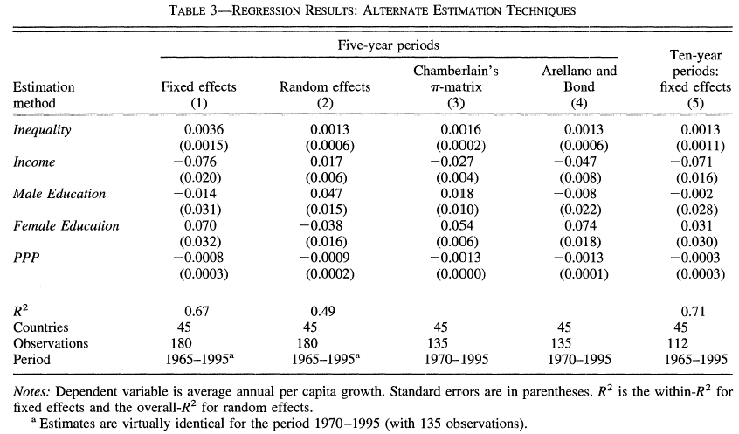
Results

Slide 21
Coefficient of initial income is negative (suggesting convergence).
That of Male education is negative;
That of female education is positive.
All these results agree with the previous literature except for inequality.
A ten- point increase in inequality is correlated with a 1.3 percent increase in average annual growth for the next five years.

Slide 22
Two points to notice:
While the negative relationship found in the previous studies is interpreted as “countries with high levels of inequality tend to have lower SS income”, the current study focuses on the impact of inequality on growth within the same country.
The previous studies focused on the long- run relationship, while this study focuses on the short- or medium- run relationship. If the period is extended to 10- years as in col. (5) with fixed effects, however, the effect which was positive and significant in col (2) are now positive but not significant.

Slide 23
Next goes on in Table 4 to investigate the effects of using data of differing quality with OLS and Arellano-Bond

Slide 24
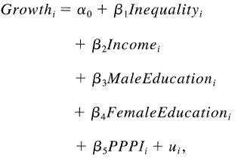
Perotti’s results are shown in table 4. Five explanations for the differences in results are possible:
Perotti defines two variables differently. Income share of the middle class is used to measure inequality; initial income is used instead of log (initial income). Using LQ dataset (as Perotti) and Forbes’ definitions, OLS is used to estimate the model (col. 2):

Slide 25
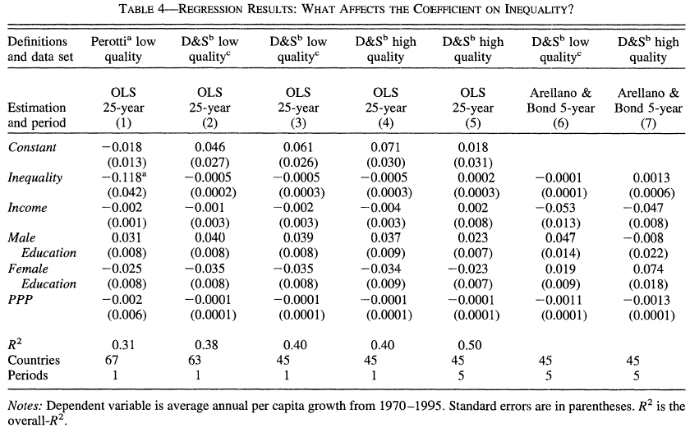
What Affects the Inequality Coefficient?

Slide 26
Different Sample (different set of countries): Use Low Quality (LQ) dataset (but for the countries included in Deininger and Squire (col 2) and then Forbes’ study) (col. 3).
Perotti’s Sample is LQ: Use HQ dataset for the same sample of countries as in col. 3 (see col. 4).
Different period length: Use HQ dataset as before but with panel (5 periods) and OLS (see col. 5).
Perotti doesn’t correct for omitted- variable bias (by including country fixed effects): Use LQ dataset, same sample as in col. 3, but apply Arellano and Bond method (see col. 6).
The difference that matters most is the Arellano-Bond method.

Slide 27
Sensitivity Analysis
Small sample size may make the effect of outliers significant. The model is estimated removing one country at a time, and removing the lowest and highest inequality countries.
Different countries are included in each period. The model is estimated using the countries which have data for the five periods.
The coefficients may be changing over time such that pooling is not allowed: Estimating the model for subsets of periods.
Sample is unrepresentative for regions: estimate the model excluding OECD, East Asia, and Latin America.

Slide 28
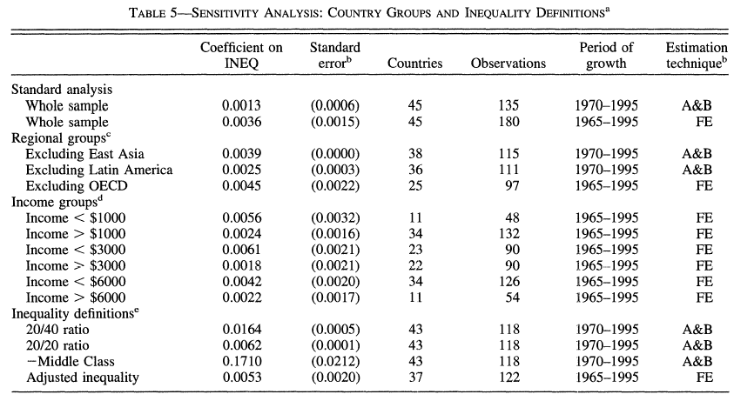
Sensitivity Analysis Results

Slide 29
Relationship may depend on the level of development: Include inequality squared; split the sample based on income (as suggested by Barro)
Different variables definitions: use different measures of inequality, and other variables.
Gini coefficient is obtained from different sources (even for the same country): estimate the model using only countries which have one source.
Table 6 shows results for different model specifications: use models from various previous papers. In each case, Three estimation techniques are used: Cross- country OLS, pooled OLS, and Panel FE.

Slide 30
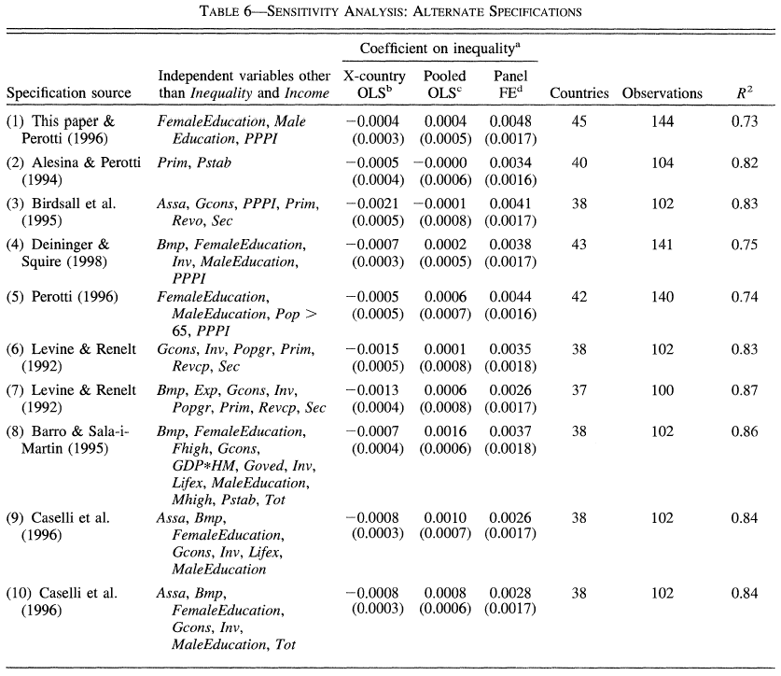

Slide 31
When using OLS, the coefficient is negative. Pooled OLS produces insignificant coefficient. FE estimation leads to a positive and significant relationship. Hence, omitted- variable bias is important. Though results for very poor countries may be questioned due to very small sample and possible non-representativeness of them
What omitted variables might cause this? (Corruption, since it is + correlated with inequality, - correlated with growth or share of G on basic health, educ
The results might support the idea that there is a tradeoff between reducing inequality and promoting growth. However, measurement error is still a problem Panel does not control for omitted variables that change over time since omitted variables could be correlated over time .
The results are not necessarily contradicting the previous studies. The result is merely a correlation with no contribution to how these variables are connected.

Slide 32
Comments
Sample may be unrepresentative of some regions such as Transition countries (only 3 and entirely before transitions wherein inequality rose and growth slowed), 2 in MENA, 0 in SSA, and for all LDCs not after 1990 when inequality rose with reforms and growth in many cases lowered
But very careful in methods of estimation and sensitivity analysis

